Slide 1

ShareRyde
Daksh Vyas
Harsh Panchal
Thomas Smith
Saleh Alshetaiwi
Hari Vamsi
MIE 670 Technical Project Management
Professor Nehal Patel
Fall 2023

Slide 2
Project Description
Many people own cars that go unused for long periods during the day or week. This results in wasted value for the car owner and wasted opportunity for car renters.
ShareRyde connects these vehicle owners with vehicle renters. Allowing owners to earn extra income by renting their cars during times they aren't being used. While offering renters a cheaper and more convenient short-term transportation option.

Slide 3
Purpose
Address the problem of underutilized personal vehicles and the inefficiency of traditional vehicle rentals.
Connects car owners with customers wishing to purchase a short-term rental of a vehicle
Disrupt the car rental industry by providing a more convenient and affordable rental service
Allow people to use their personal vehicle as an asset more than just a tool

Slide 4
Scope
Mobile App for Renters and Drivers: Create mobile app for drivers and renters to connect with each other. The application will include a feature to allow users to make their car available to people looking to rent during times the car is not being used. It also enables users to communicate with each other and will process payments.
Legal Compliance and Insurance: Conduct the needed legal processes to obtain proper licensure. Find economic insurance policies that offer necessary coverage. Work with traffic agencies to comply with federal and regional transportation laws.

Slide 5
Scope continue
Marketing and Community Outreach: Implementation of a strong marketing strategy using digital media, local partnerships, and community events to foster trust and encourage platform adoption.
Customer Experience Management: Establish a team to manage customer questions, feedback, and driver renter disputes. Ensure quality service standards and positive user reviews.

Slide 6
Assumptions
Market Need: Many people want easier and cheaper ways to rent cars.
Car Owners: Enough car owners are ready to rent out their cars when they're not using them.
App Use: People renting cars and drivers are okay with using an app.
Laws: ShareRyde will follow all the laws in the places it works.
Insurance: We can get good insurance for cars and drivers.
App and Service: Our app and customer service will be easy to use.
Making Money: The money we make from rentals will be enough to run the business and make a profit.

Slide 7
Work Breakdown Structure (WBS)
ShareRyde
Renter Feature
Driver Feature
Marketing
Legal and Regulatory Compliance/Documentation
Booking Interface
Renter Interface
Ad Line to Renters
Insurance
Scheduling Algorithm
Vehicle inventory management
Promotion Line
Safety
Customer Profile Database
Payment Integration
User Verification
Payment Integration
Customer Support
Notification System
Customer Support

Slide 8
Cost Breakdown Structure (CBS)
ShareRyde
(2 Million)
Renter App(670k)
Driver App(570k)
Marketing(280k)
Legal and Regulatory Compliance/Documentation(530k)
Booking Interface(150k)
Renter Interface(210k)
Ad Line to Renters(80k)
Insurance(150k)
Scheduling Algorithm(90k)
Vehicle inventory management(200k)
Safety(190k)
Promotion Line(200k)
Customer Profile Database(100k)
Payment Integration(60k)
User Verification(190k)
Payment Integration(120k)
Customer Support(100k)
Notification System(110k)
Customer Support(100k)
Assuming a contingency margin of 10% or $200k

Slide 9
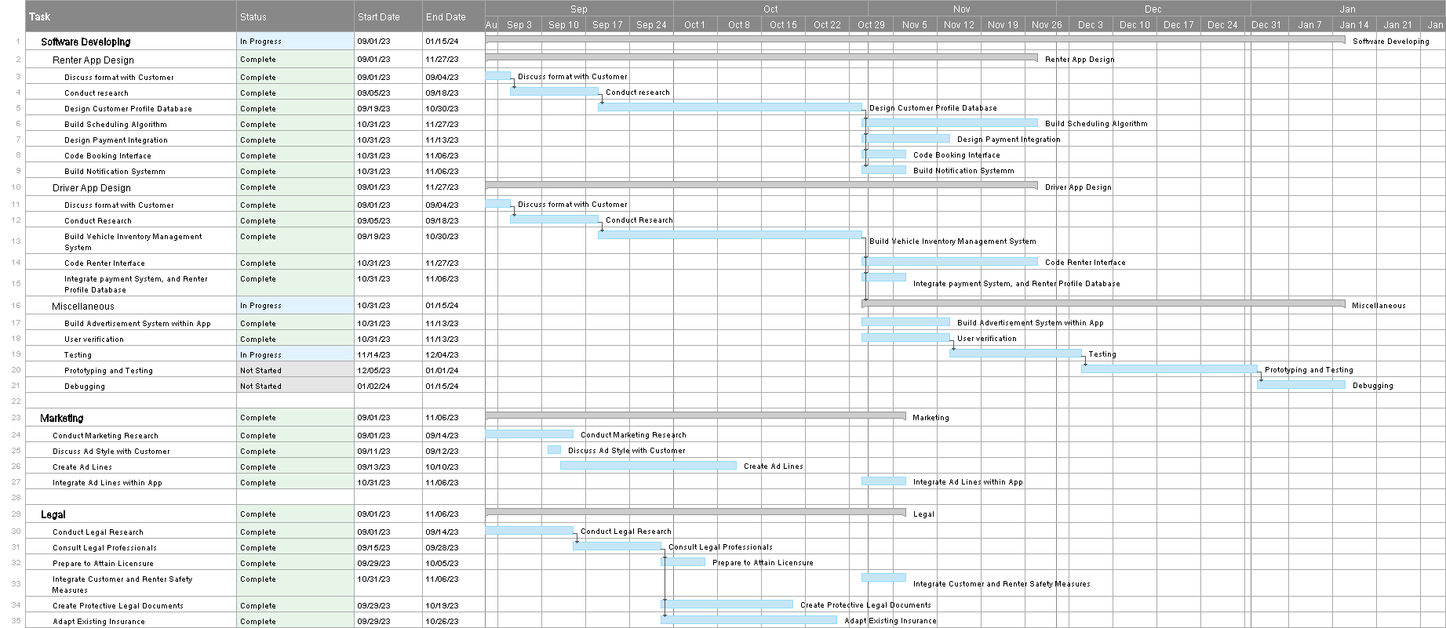
Schedule Management
Key Milestones

Slide 10
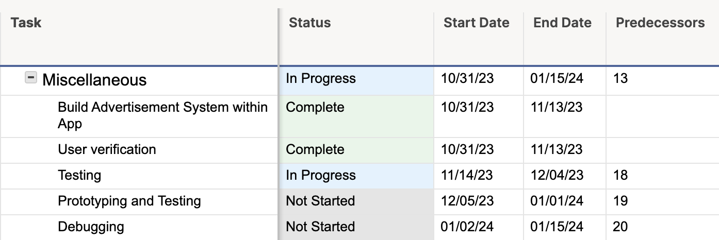
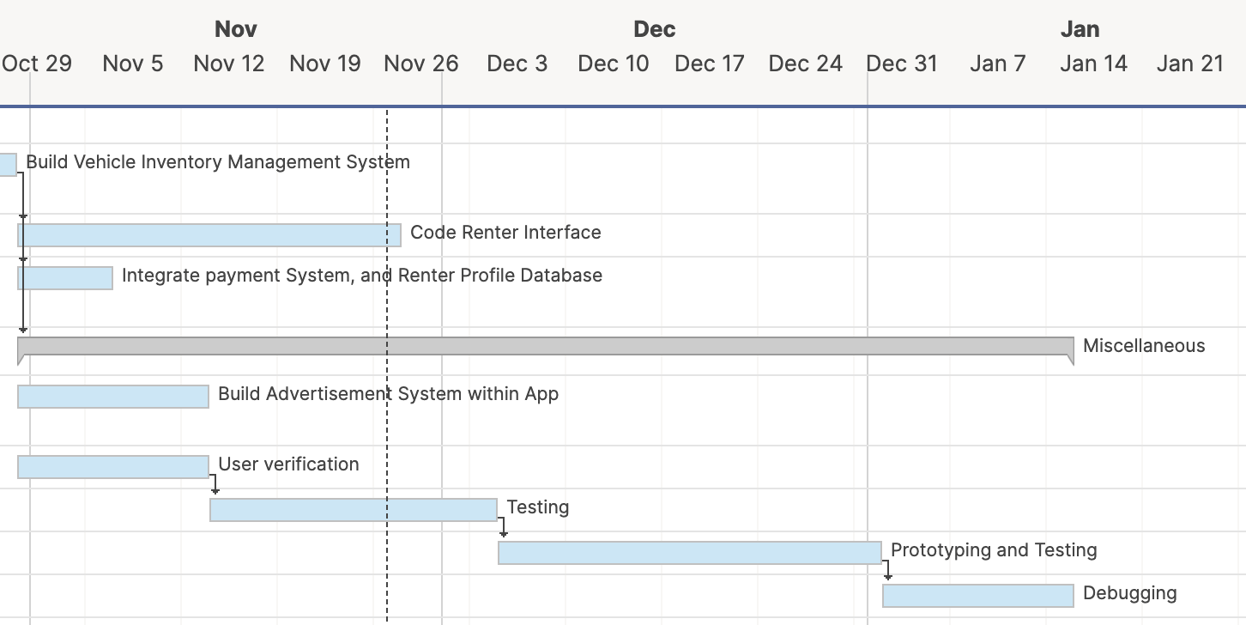
Schedule Management

Slide 11
Critical Path
Task | Start Date | End Date | Duration | Status
Discuss format with customer | 9/1/23 | 9/4/23 | 3 | Complete
Conduct research | 9/5/23 | 9/18/23 | 13 | Complete
Build vehicle inventory management system | 9/19/23 | 10/30/23 | 41 | Complete
User Verification System | 10/31/23 | 11/13/23 | 13 | Complete
Testing | 11/14/23 | 12/4/23 | 20 | In Progress
Prototyping and Testing | 12/5/23 | 1/1/24 | 27 | Not Started
Debugging | 1/2/24 | 1/15/24 | 13 | Not Started
Total Duration: 97 days

Slide 12
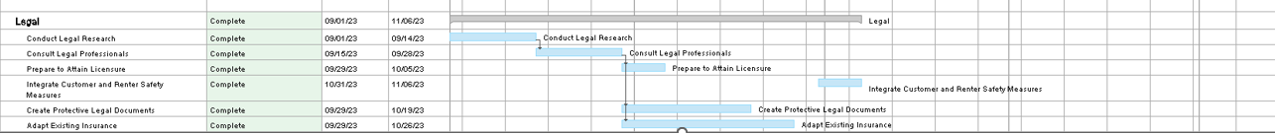
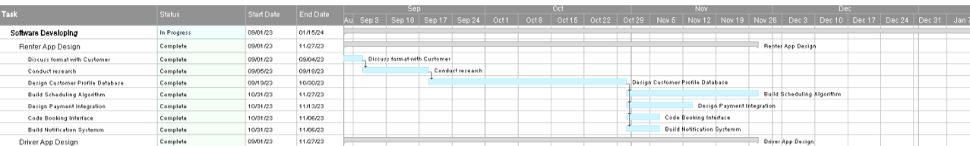
Recovery of Schedule
Parallel Activities
Subsequent tasks
Outsourcing non-critical activities to other teams/vendors
Frequent process updates, critical path monitoring, and adaptive re-plan.
Examine near-critical path tasks for potential resource optimization

Slide 13
Potential Risks
Car condition and safety
To perform a safety and condition check of the car to be rented out
Data Privacy
To protect the data of users for maintaining their privacy
Security system
Use of strong security method for allowing the access to verified users and admin only
Verification of the users to prevent any fraud and damage to the company
Insurance/car paperwork
Ensuring the car has all the legal paperwork like car insurance also the user’s driving license verification
Competition against rivals
To build a strong methodology and strategy to compete with rivals and to be in profit

Slide 14
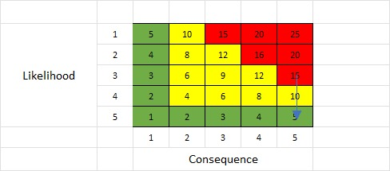
Likelihood/Consequence Analysis
If
Then
The condition of the listed car by the renter doesn't match with what he mentioned in the description
The process will be delayed and need to do a condition and safety check by the team
Mentioning the imperfections of the vehicle and reducing the price of the car accordingly
The L/C Index is 15(red), so the risk likelihood needs to brought down to 5(green)

Slide 15
Cost Mitigation
Partnerships
To build a strong partnership with service providers and stakeholders this will be beneficial in future for long term business goals
Insurance cost
Try to get the best possible rates of insurance policies which can be helpful in cost cutting
Pricing Factor
Keep the rates affordable and flexible so every user can use the system and also to be in profit so it could be a win win situation for both
Regular System optimization
Try to figure out any cost saving options in current system and make changes according to user needs or make any updates to system which will be beneficial in long term

Slide 16
Mitigation of Schedule
Strong Project planning
Give more time in proper planning of the project and detailed schedule with all the tasks and deadlines. Doing the research and understanding the user needs
Risk Planning
First identification the potential risks and to do some preplanning for avoiding it.
Team Communication
Establish an effective way for team communication and make sure that everyone is aware about their tasks.
Get regular updates and do team meetings to get the update of the work.
Vendor Management
Try to work closely with the vendor and also make them understand about the requirements and deadlines
Multitasking
Try to run multiple tasks simultaneously which will decrease the overall project time period

Slide 17
Mitigation of Performance
Use of strong user verification
This can be achieved using two-factor authentication.
Use of effective database
This can be helpful in retrieving details and required data even in high bookings situations.
Use of secure and robust payments system
A high-level secure payment system is required for processing and implementing all the payments and refunds to the customers and renters
Feedback System
Use of proper user feedbacks for improving the system performance and user requirements
Updates to user
Providing regular updates to users about offers and other notifications like successful
booking and payment.
Recovery system data
Use of effective data recovery system in case of some failure and do regular checks of
the severs and regular backups

Slide 18
Conclusion
Completion Date: January 15, 2024
Total Cost of Project: $2 million
With ShareRyde, the future of the rental car industry is one of convenience, reliability, and affordability
Join ShareRyde Soon!

